Slide 1
IPR & CYBER LAWS
TYPES OF IPR

Slide 2
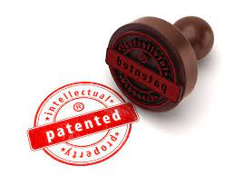



TYPES OF IPR
COPYRIGHTS
TRADEMARKS
PATENTS
TRADE SECRETS
GEOGRAPHICAL INDICATIONS

Slide 3
COPYRIGHTS

Slide 4

copyrights
Copyright is a legal term used to describe the rights that creators have over their literary
and artistic works.
Works covered
by copyright range from
music, paintings,books
sculpture, and films, to computer programs, databases, advertisements, maps, and technical drawings.

Slide 5
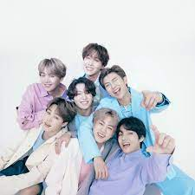
BTS & Big Hit Entertainment (HYBE) v. Bryan Kahn
BTS appeared as guests on a television series I-Land back in 2020. Bryan Kahn, a resident of Florida and proclaims himself to be "engaged in the business of creating and producing television series and audio music,” claims his idea for a similar show was stolen. The show, which was called "Island Hip Hopping" was registered with the Writers Guild of America back in 2013. To prep for the show, he moved around different countries in Asia to learn more about the culture and was apparently set to being production in 2020.

Slide 6
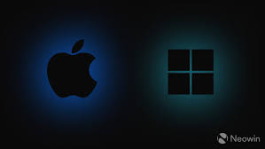
Apple vs. Microsoft
Copyright is most commonly associated with the protection of books, songs, films and other forms of entertainment, but this is far from the full range of works it may cover. The audiovisual elements of a computer’s graphical user interface (GUI), now an integral element to modern computing, are also subject to copyright. A dispute over the ownership of one of the first invented GUIs would form the core of one of the most formative copyright infringement lawsuits in the tech sector

Slide 7
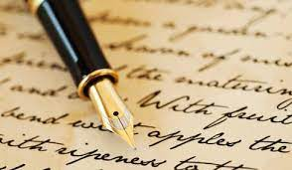
Literary Works
Any work that is expressed in words, numbers or any other verbal and numerical symbols, but isn’t an audiovisual work, is considered a literary work. That includes such things as manuscripts, books, phonorecords, cards, disks, film, and tapes are among some of the written materials that are considered protected under copyright law.
On a much narrower level, such things as novels, short stories, letters, movie scripts, cooking recipes, email messages, mathematical proofs, and computer programs also qualify as original works of creative expression and are protected under copyright law.

Slide 8


Dramatic Works
Dramatic works, whether published or unpublished, are also protected under copyright law. These include such as things as plays, scripts for cinema, television, and radio, pantomimes, and works of choreography.
Of course, we should remember that the main determinant for whether such works qualify for copyright protection is originality. However, we should also remember that there are many elements to a dramatic work, such as the directions for actions, the spoken text, and the plot. All of these will play a role in determining whether the work qualifies for copyright protection.

Slide 9
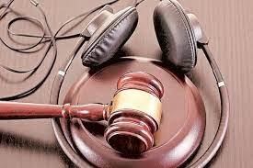
Ilayaraja, music and the ever -lasting confusion over copyright
The composer has been highly litigious in the past few years, fighting for the rights over his music. His complaint is that he has not received his rightful dues and has been cheated over royalty payments. In 2010, he lodged a complaint with the Chennai police that a private firm had commercially exploited his music without his knowledge. The Echo Recording Company, with which producers of various films had entered into agreements, had not paid him royalty. They had sold the music rights to other companies illegally.

Slide 10
TRADEMARKS

Slide 11
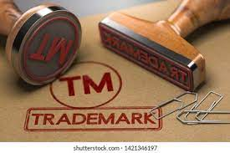
TRADEMARK
The term trademark refers to a recognizable insignia, phrase, word, or symbol that denotes a specific product and legally differentiates it from all other products of its kind. A trademark exclusively identifies a product as belonging to a specific company and recognizes the company's ownership of the brand.

Slide 12

HONDA
In order that American Honda may establish and maintain an effective network of authorized dealers for the sale and service of Honda Products, Dealer specifically agrees that it will not display Honda Trademarks, or, either directly or indirectly, establish any place or places of business for the conduct of any of its Dealership Operations except at the locations and for the purpose described in Paragraph E of the Agreement without the prior written approval of American Honda.

Slide 13
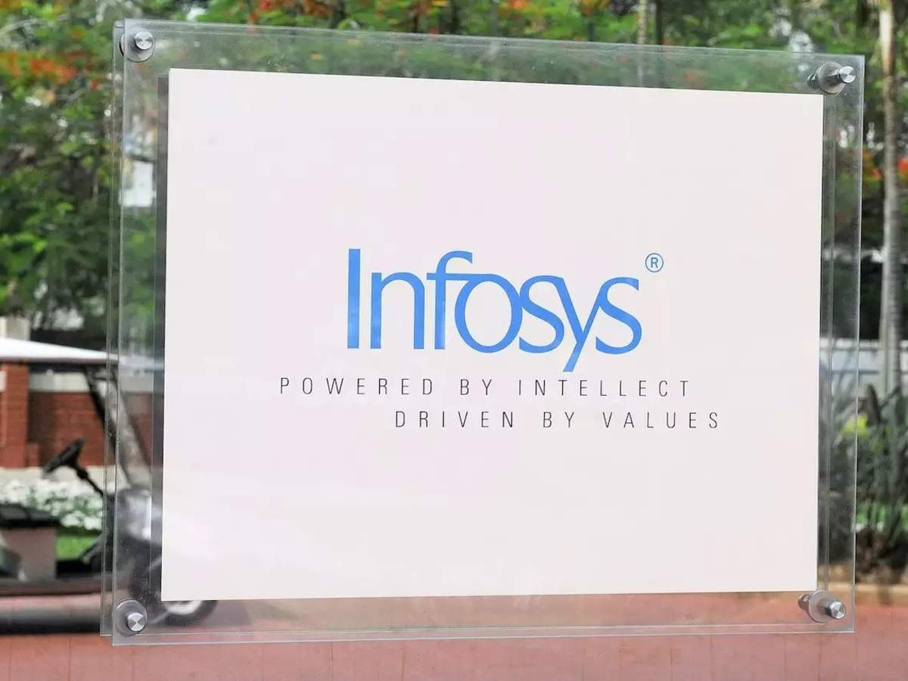
Infosys
Infosys is a Device Trademark filed on 18 August 1994 in Karnataka through Chennai IP Office. The Trademark was registered to M/S. Infosys Limited Trading As : M/S. Infosys Limited Body Incorporate and is valid till 18 August 2024.

Slide 14
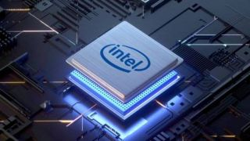
INTEL
Famous and well-known trademarks especially those that embody a reputation of pre-eminent excellence and quality, as plaintiffs Intel trademark, are required to be given a broad protection.

Slide 15

GOOGLE
Google provides translated versions of our Help Center as a convenience, though they are not meant to change the content of our policies. The English version is the official language we use to enforce our policies. To view this article in a different language, use the language dropdown at the bottom of the page.

Slide 16
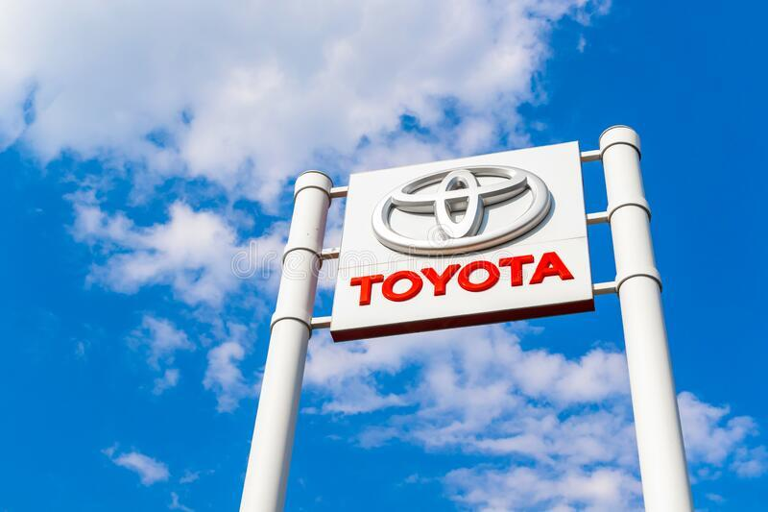
TOYOTA
The Toyota name and logos, as well as Toyota model names, are trademarks of TMC. The Toyota logos may not be used, downloaded, copied, or distributed in any way. Other trademarks and trade names are those of their respective owners.

Slide 17
PATENTS

Slide 18
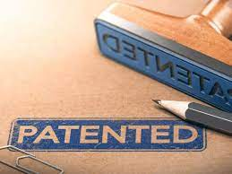



PATENT
A patent is an exclusive right granted for an invention, which is a product or a process that provides, in general, a new way of doing something, or offers a new technical solution to a problem. To get a patent, technical information about the invention must be disclosed to the public in a patent application.

Slide 19
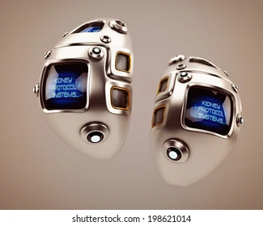
Steel kidneys
After receiving a grant from the state in 1946, Nils Alwall, a doctor in Lund, began developing a dialysis machine for people suffering from kidney disease. Just over twenty years later, his inventions started to be mass produced.

Slide 20

The Lightbulb
The electric lightbulb is perhaps one of the most famous patented inventions known to humankind. It was awarded to Thomas Alva Edison in the year 1878. However, an English inventor called Joseph Swan had received a patent for a similar product in England at the same time. Later, the two joined hands to form Edison & Swan United Electric Light Company. Edison had 1,093 patents, including the phonograph (the precursor of the gramophone and the record player) and the Dictaphone.

Slide 21
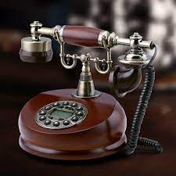
Telephone
The first telephone was invented and patented by Alexander Graham Bell in 1876. Bell went on to co found the American Telephone & Telegraph Company (AT&T). Later, the company expanded to control all telecommunications and become the world’s most significant in the industry and is an industry behemoth today.

Slide 22
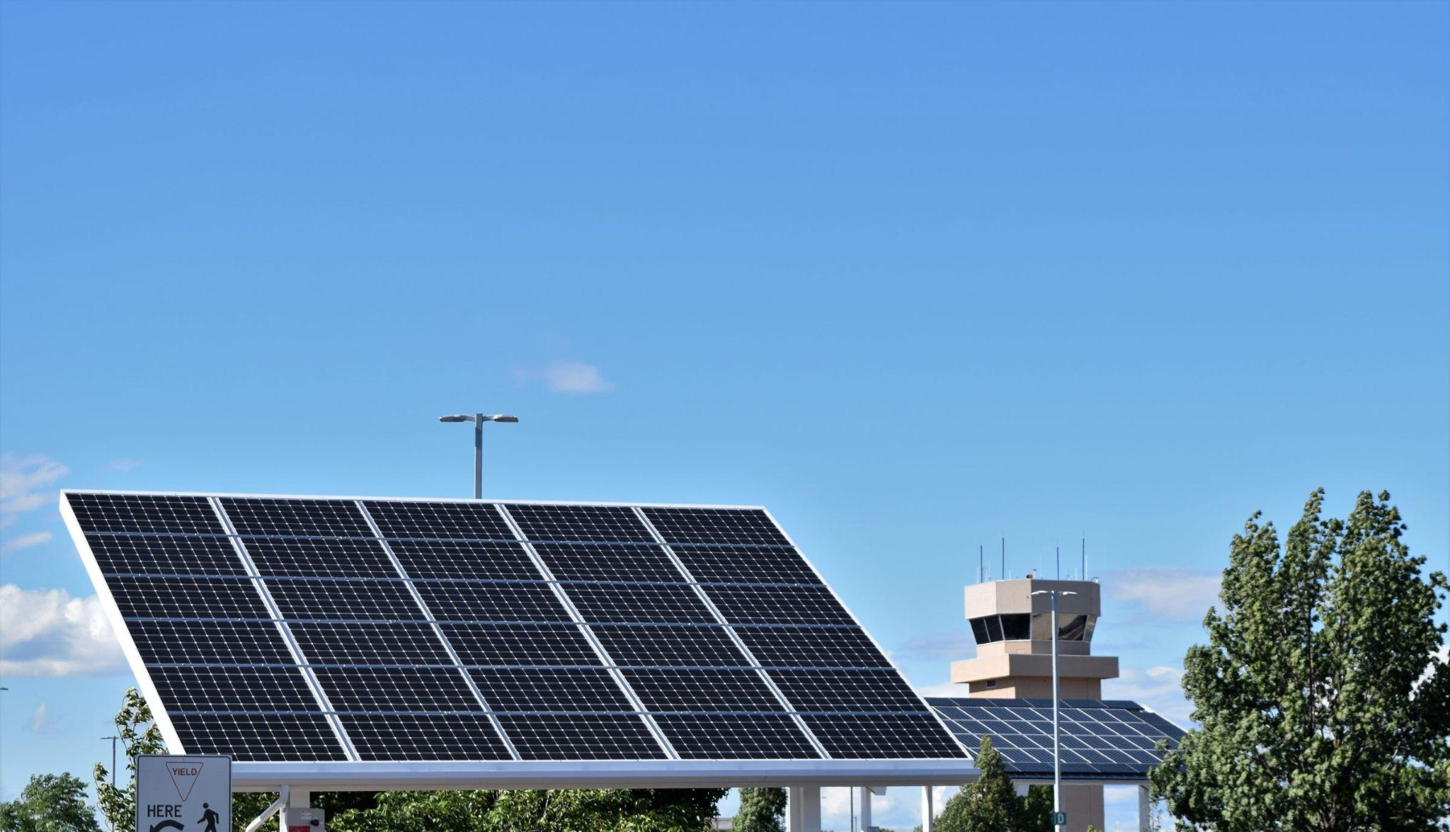
Solar Panel
In the early 19th century, French physicist Edmund Becquerel discovered that certain materials generate a small electric current when exposed to light: the photovoltaic effect. In 1839, he created the first photovoltaic cell by connecting silver chloride placed in an acid solution to platinum electrodes.

Slide 23

Google PageRank
Larry Page developed it in 1998. It gets its name from his surname ‘Page’. It calculates the importance of a webpage by counting the number and quality of links attached to it.

Slide 24
Trade secrets

Slide 25
Trade secrets
trade secret is information such as a formula‚ pattern‚ compilation‚ program‚ device‚ method‚ technique‚ or process that derives a unique and significant value from its secrecy. In other words‚ a trade secret is valuable because it is kept secret. While the information may be useful or beneficial to others‚ by keeping the information secret‚ trade secret holders are able to monopolize the information for their benefit. For more information, see our trade secret law and trade secret litigation pages.

Slide 26
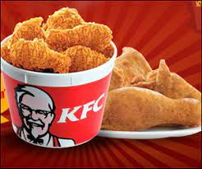
KFC
It is purported that the recipe of Colonel Harland sanders finger-licking is known to only 2 KFC executives. This is the amount of importance a trade secret carries which can make a business grown in billion dollars and also turn a billion-dollar business into a full zero.

Slide 27
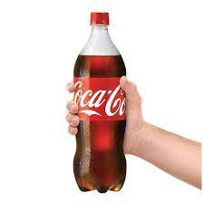
COCA COLA
COCA COLA made a choice to brand the recipe a trade secret instead of patenting it, which would have lead to the disclosure of the ingredients.
Since one of those ingredients may have been cocaine, Coca-Cola decided to keep the recipe as confidential information.

Slide 28

GOOGLE
The company offers a variety of software and Internet-related services and solutions, including web browsing and searching, cloud computing, streaming entertainment, mobile operating systems and applications, and more. Alphabet leverages its various platforms and services to generate a substantial portion of its revenue from advertising.

Slide 29
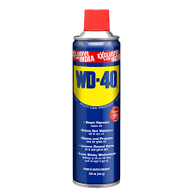
WD-40
Originally WD-40 was developed to prevent corrosion. The chemist kept the formula secret and sold it a few years later. Even now, it is the company’s only product.
Like Coca-Cola, the secret formula has never been patented, so competitors could not discover what is in it. The company does reveal what is NOT in the formula, including a statement that there are no known cancer-causing agents.

Slide 30
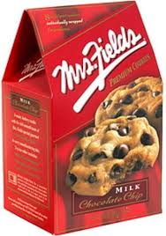
Mrs. fields chocolate chip
Mrs. Fields chocolate Chip Cookies, it's only natural they'd want the recipe. But it's a secret, says the company. Bakers have long tried to figure out the recipe themselves through a process called reverse engineering, but most want the real thing.

Slide 31
GEOGRAPHICAL INDICATIONS

Slide 32
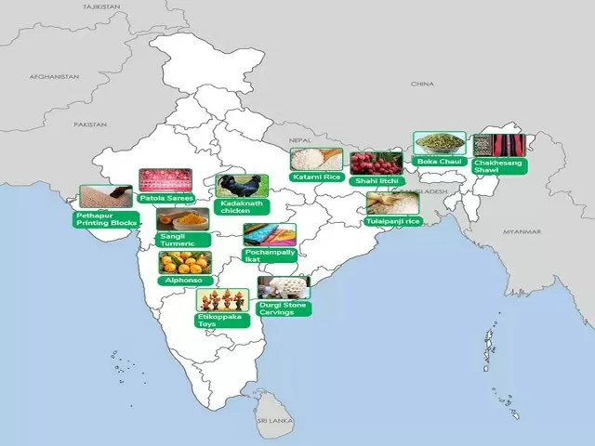
GEOGRAPHICAL INDICATIONS
A GI tag is a sign used on products that have a specific geographical origin and possess origin-based qualities and reputation in the region.
Keep in mind that the characteristics, qualities, and popularity of the product should be essentially due to the place of origin.
Geographical indications tags are given to foodstuffs, handicrafts, industrial products, wine and spirit drinks, and agricultural products

Slide 33
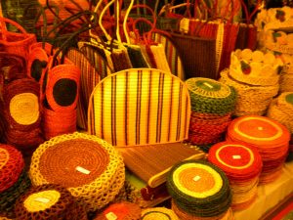
ALLEPPEY COIR
Coir Mats Description of goods "Alleppey coir" is a geographical indication used for the coir mats and mattings and carpets produced out of handloom by the traditional coir workers in the Ambalappuzha, Cherthala taluks of Alleppey district.

Slide 34
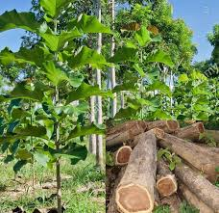
Nilambur Teak
Kerala's Nilambur teak, known internationally for its superior timber quality and elegant appearance, has been accorded with the Geographical Indications (GI) tag by the GI Registry of the Government of India. Nilambur Teak is the first forest wood product accorded with GI status in the world.

Slide 35
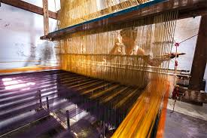
Kancheepuram Silk
The Kanchipuram silk sari is a type of silk sari made in the Kanchipuram region in Tamil Nadu, India. These saris are worn as bridal & special occasion saris by most women in Tamil Nadu, Kerala, Karnataka & Andhra Pradesh. It has been recognized as a Geographical indication by the Government of India in 2005–2006.

Slide 36
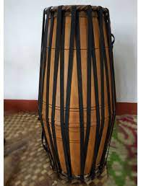
Palakkad Maddalam Kerala
The maddalam is a vital instrument in traditional Kerala percussion ensembles like Panchavadyam, Keli and Kathakali orchestra. Maddalam of Palakkad (Kerala) Of Kerala received the Geographical Indication of India tag on 22/04/2008.

Slide 37
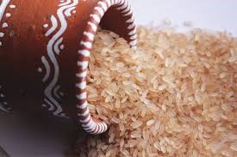
Palakkadan Matta Rice
The “Palakkadan Matta” is a unique cereal having high content of nutrients and special taste. Palakkadan Matta rice received the Geographical Indication Registry of Intellectual Property India right under the Geographical Indication of Goods (Registration and Protection) Act, 1999 in November, 2007

Slide 38
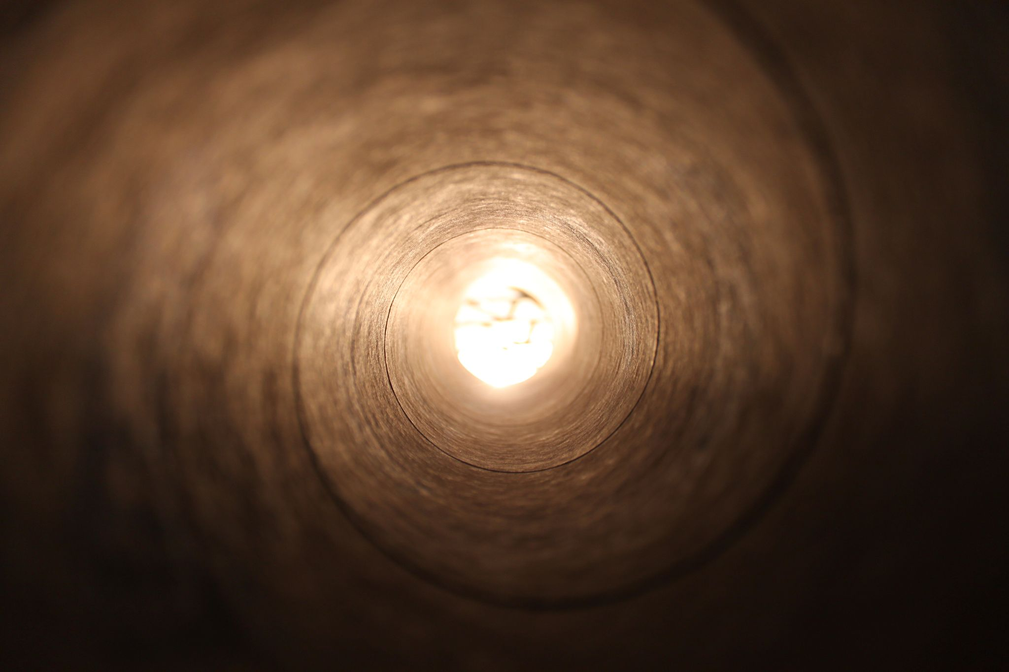
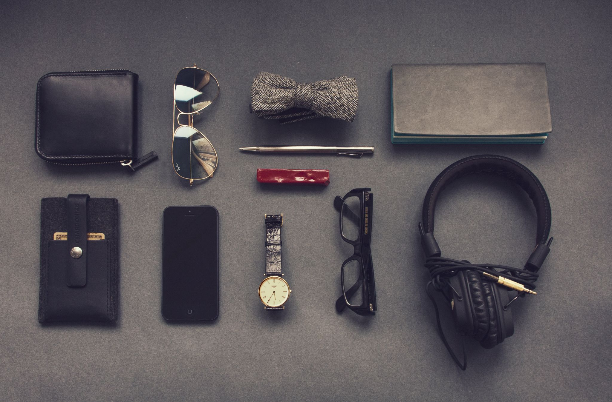
BY,
SANDRA P M

Slide 39
Thank you

